Slide 1

Performance of NEWS/NEWS2 and compliance with vital sign monitoring during the COVID-19 pandemic
Ina Kostakis Research Fellow

Slide 2
The team
Gary B. Smith
David Prytherch
Paul Meredith
Connor Price
Anoop Chauhan
on behalf of the
Portsmouth Academic ConsortIum For Investigating COVID-19 (PACIFIC-19)

Slide 3
Early warning scores
based on routinely measured vital sign observations
tools for the identification of patient deterioration
2012: National Early Warning Score (NEWS)
2017: NEWS2
Validated in a range of clinical conditions and settings

Slide 4
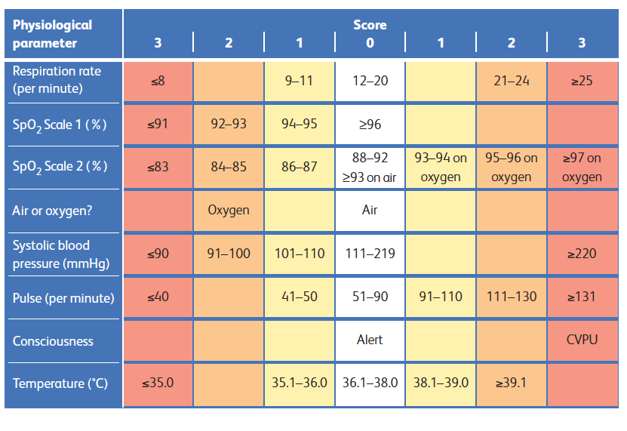
NEWS2

Slide 5



Monitoring protocols
NEWS/NEWS2 determines escalation of care and when patient should next be monitored
NEWS value?
0-2
3-4 or 3*
5-6
7-20
Min. obs^{n} frequency
360 mins
240 minutes
60 minutes
30 minutes
3* = score of 3 for a single parameter

Slide 6
COVID-19 pandemic
17th March 2020 - NHS wrote to hospitals:
discharge all medically fit, hospital in-patients
wind-down elective activity over the following 30 days
postpone all non-urgent elective operations from mid-April
expand critical care capacity
NEWS2 is currently recommended for use in patients with COVID-19 by the Royal College of Physicians of London (RCP) and the World Health Organisation (WHO)
National Institute for Health Care and Excellence (NICE) states NEWS2 may help predict risk of clinical deterioration in COVID-19 pneumonia in the community

Slide 7
Study question
How does NEWS/NEWS2 perform in patients with Coronavirus disease 2019 (COVID-19)?
How has the pandemic affected compliance with vital sign monitoring on general wards?

Slide 8
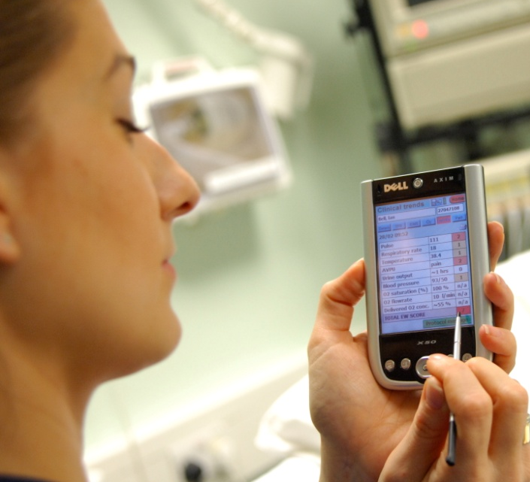
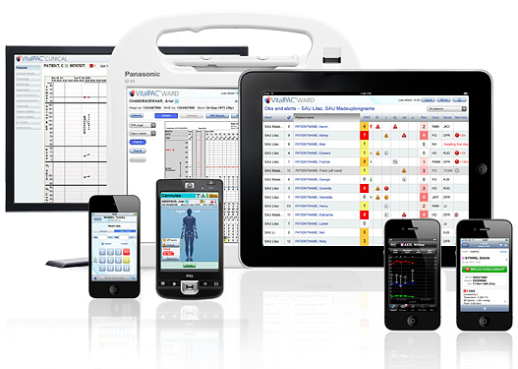
Study setting
Retrospective cohort study
Portsmouth Hospitals University NHS Trust
- large acute general hospital
Data from Jan 2018 – April 2020 (inclusive)
Demographic, admission, vital signs, PCR tests
2,867,313 vital sign sets
from 97,669 admissions
and 60,436 discrete patients
Combined outcome: death or unanticipated ICU admission
within 24h of observations

Slide 9






Data analysis
new R user & tidyverse fan
Packages used:
dplyr
lubridate
ggplot
purrr
data.table

Slide 10
Cohorts for NEWS performance assessement
11 March – 30 April
2018
2019
2020
not tested
COVID-19 positive
COVID-19 negative
COVID-19 positive patients (N = 400):
older, more male
lower O2 saturation
43% on supplementary oxygen compared to < 25% in other cohorts
Higher median NEWS

Slide 11
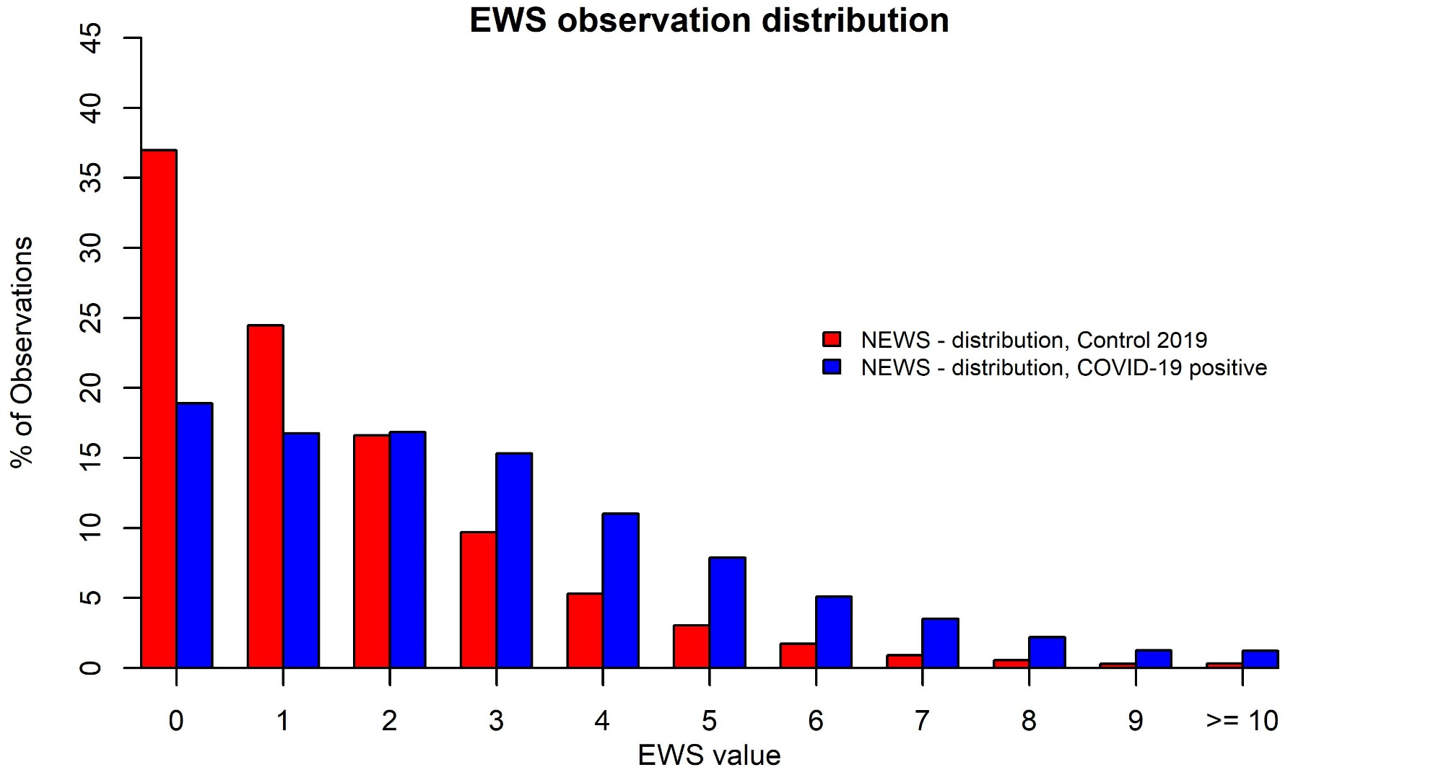
NEWS/NEWS2 distributions

Slide 12
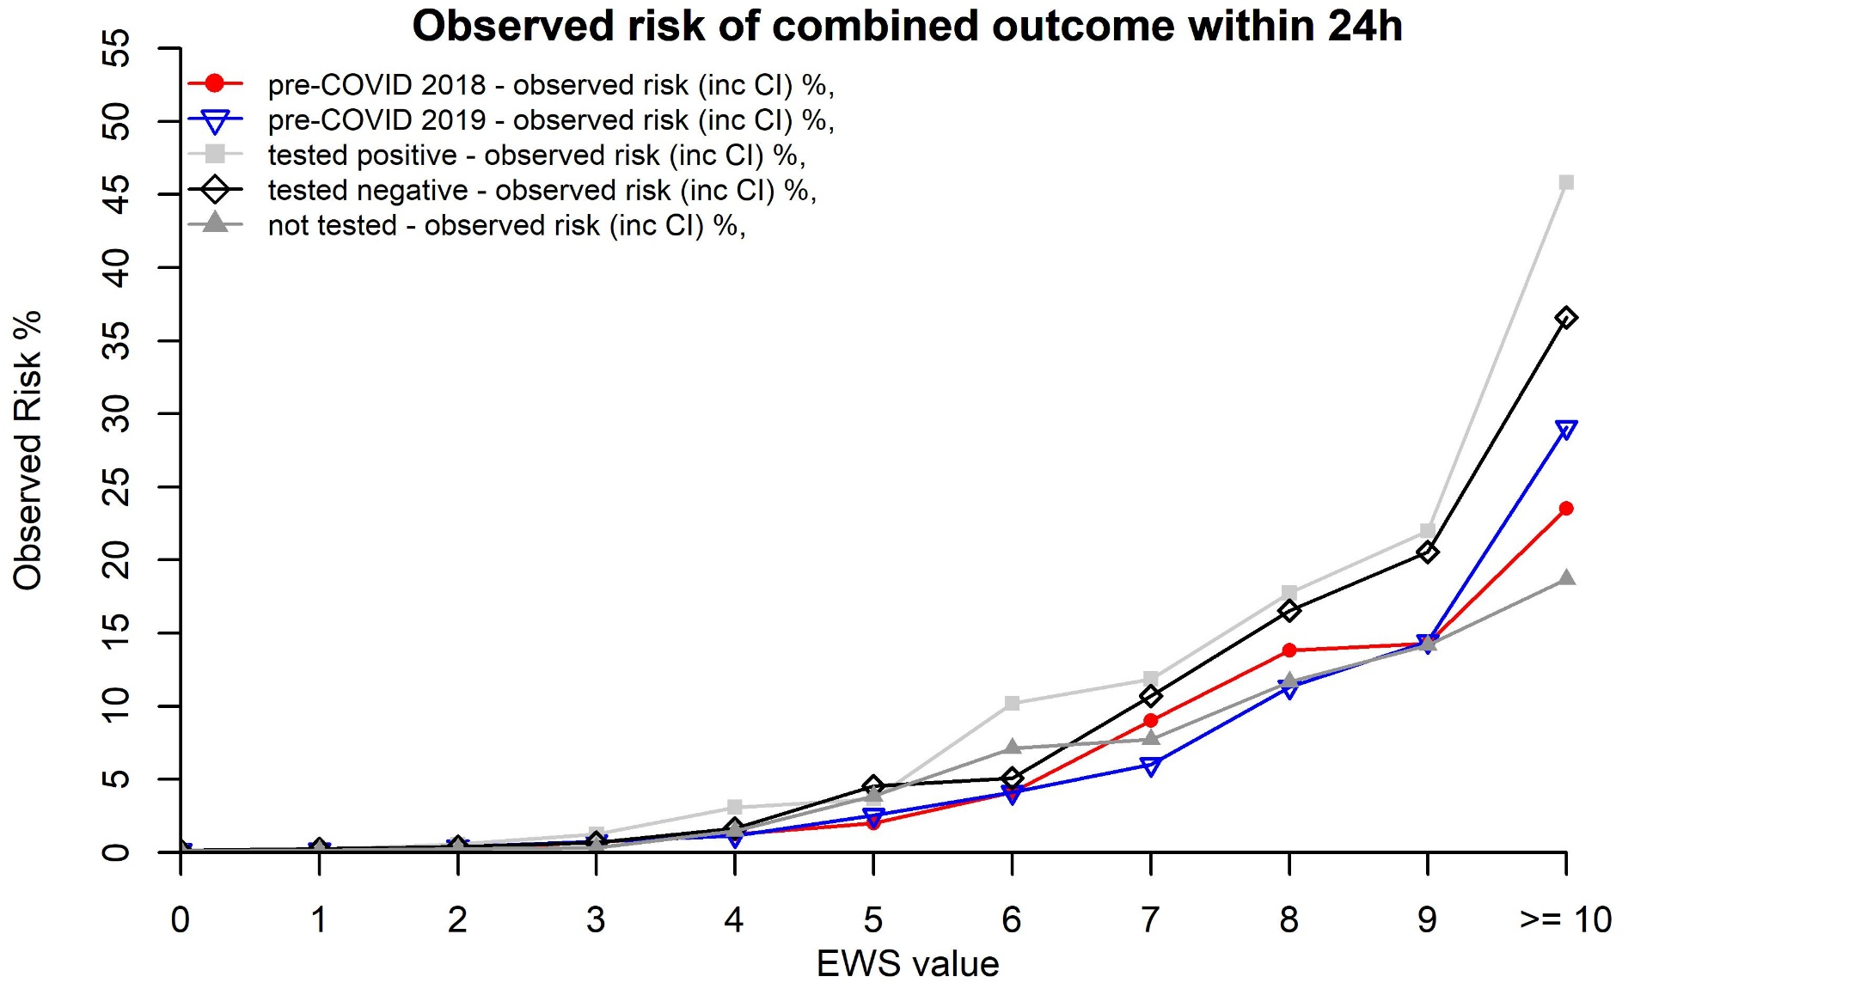
Risk of outcome

Slide 13
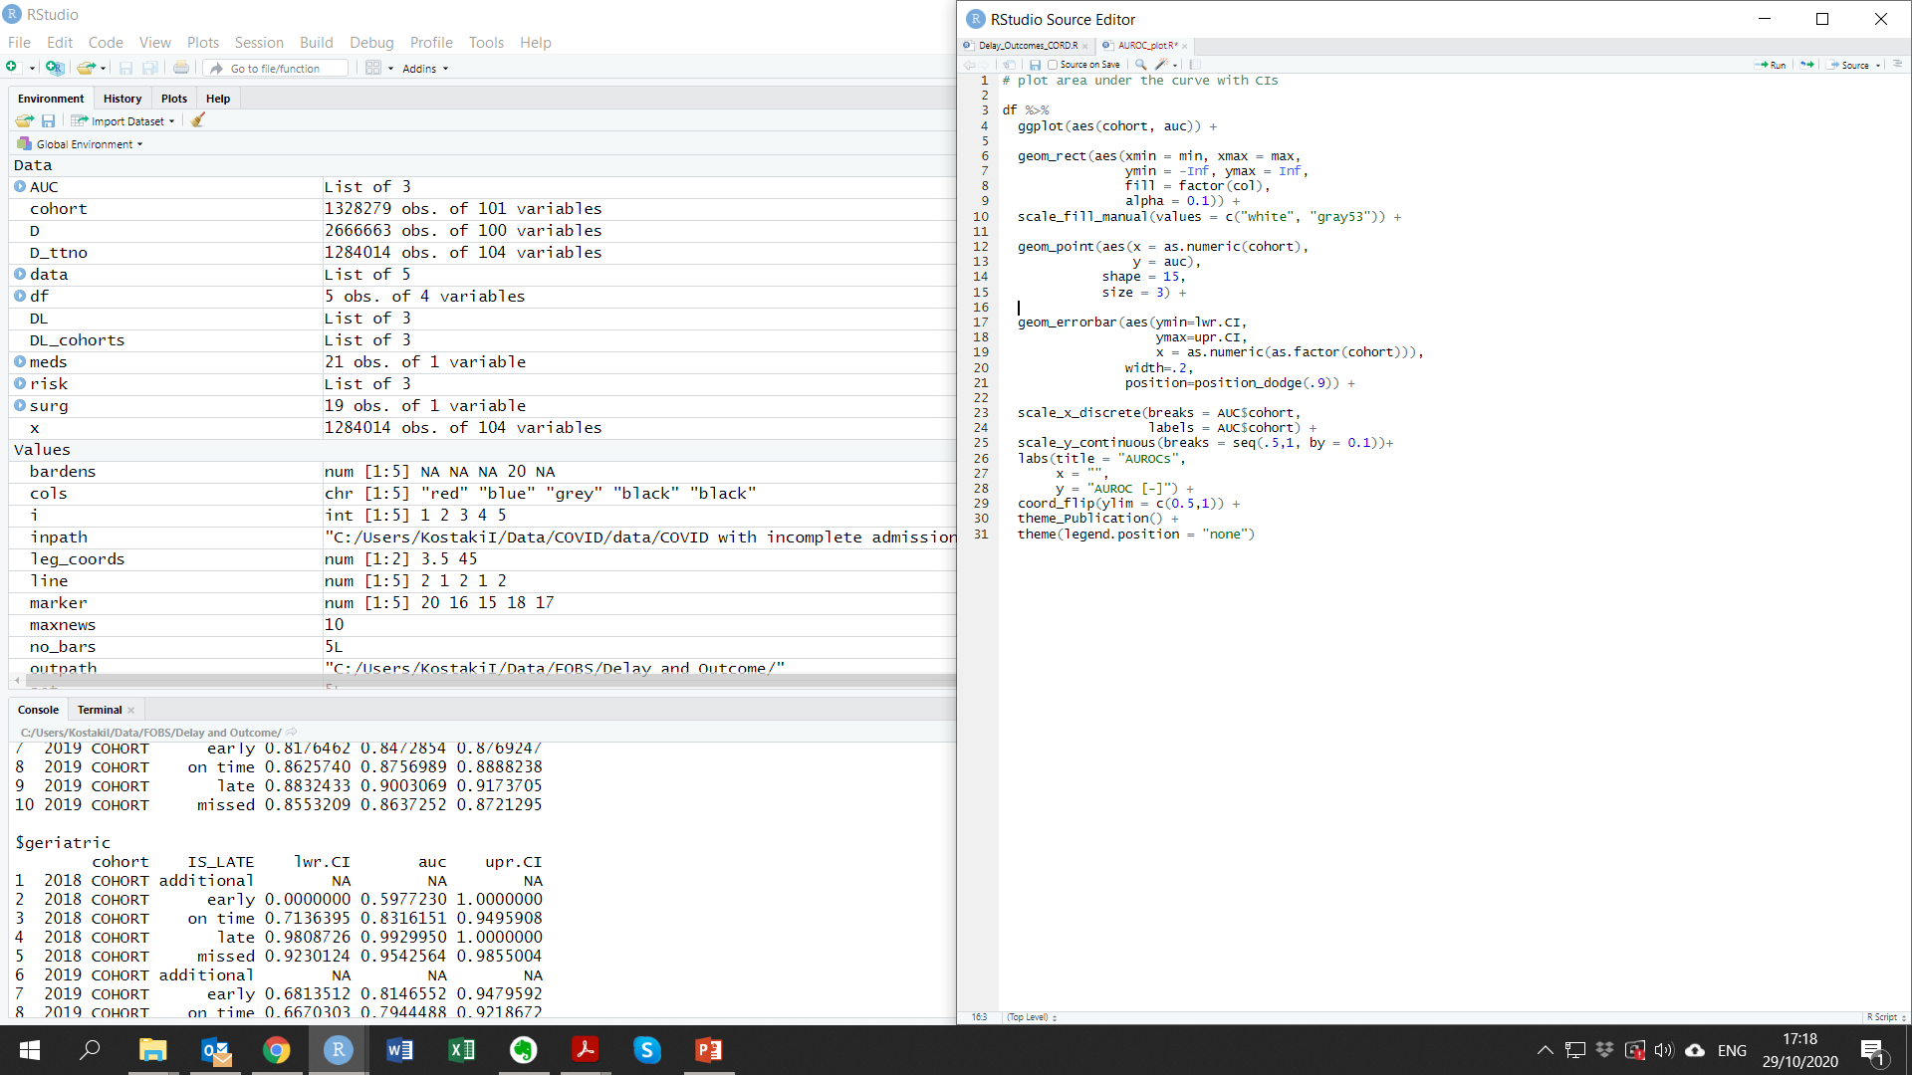
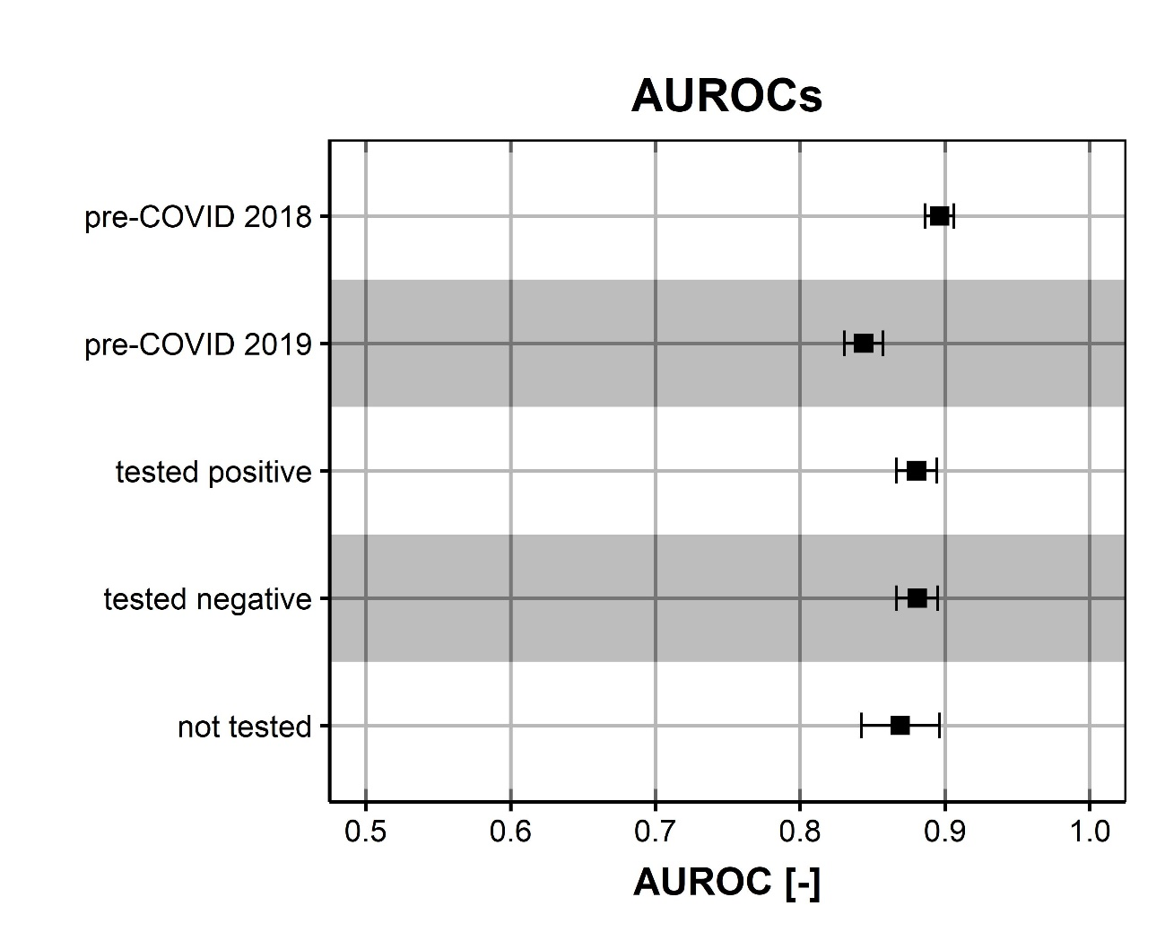
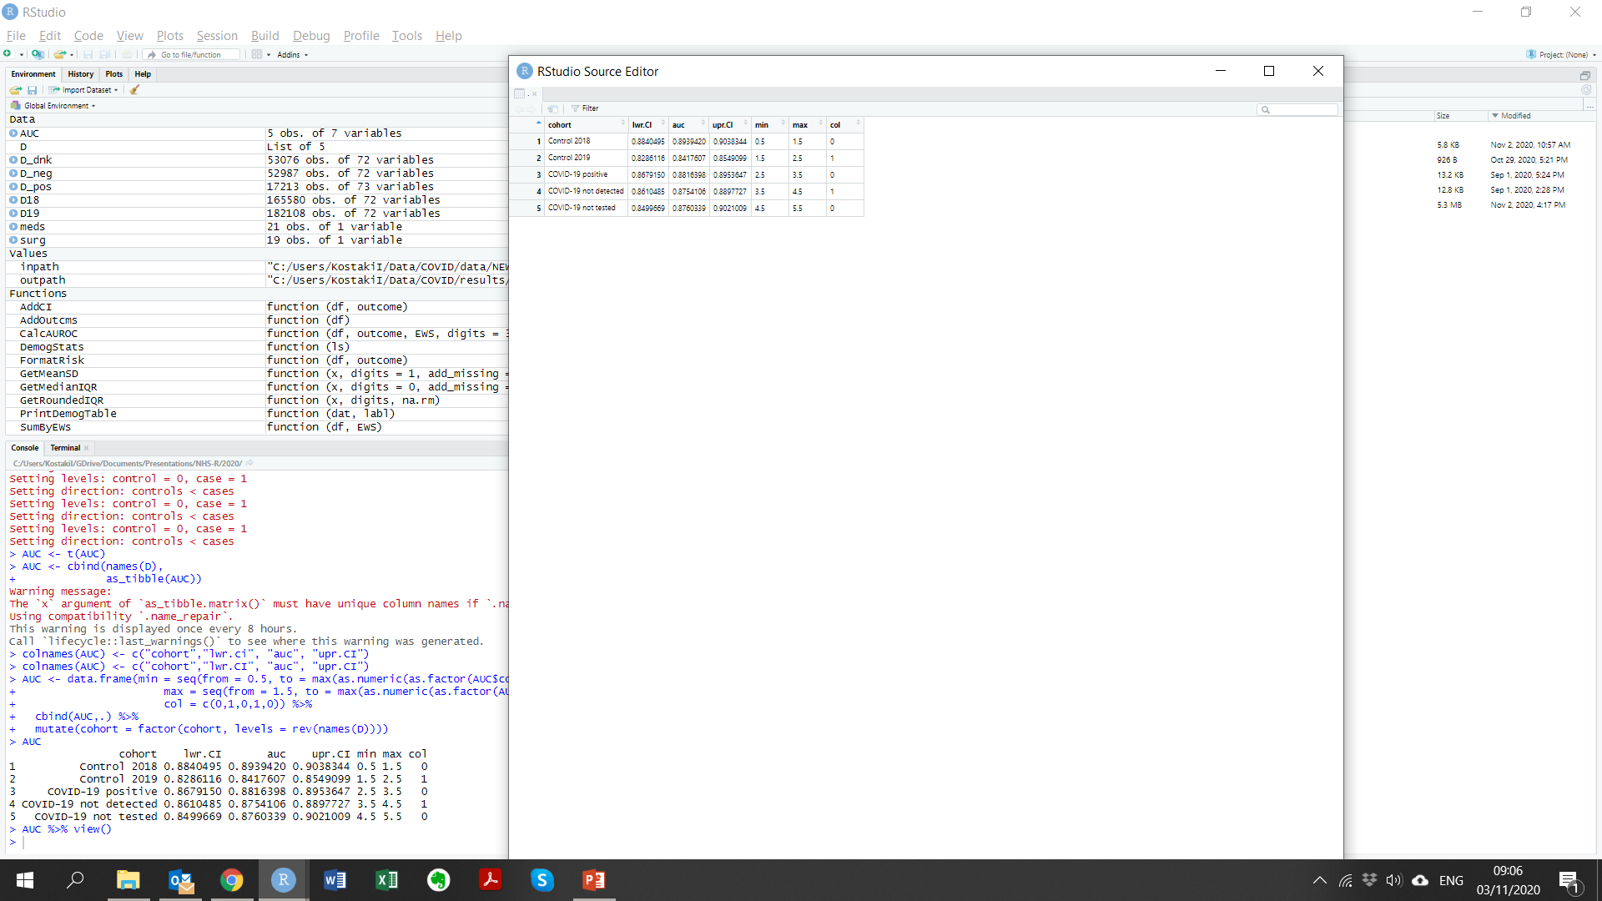
NEWS performance

Slide 14
Monitoring compliance
Assessment of system as a whole: all hospital admissions during the period, irrespective of whether the patients were tested for COVID-19
CONTROL 2018: 17/03/2018 to 30/04/2018
CONTROL 2019: 17/03/2019 to 30/04/2019
COVID-19 era: 17/03/2020 to 30/04/2020
CONTROL 2020: 01/01/2020 to 16/03/2020

Slide 15
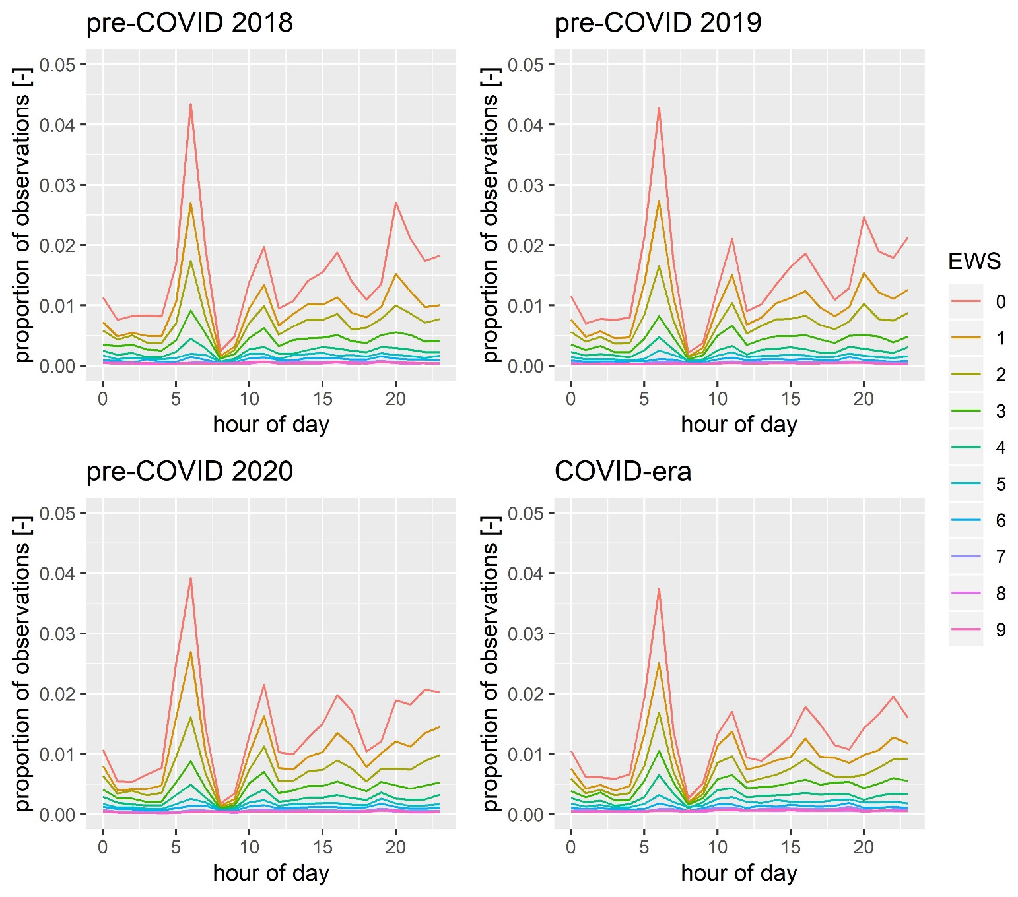
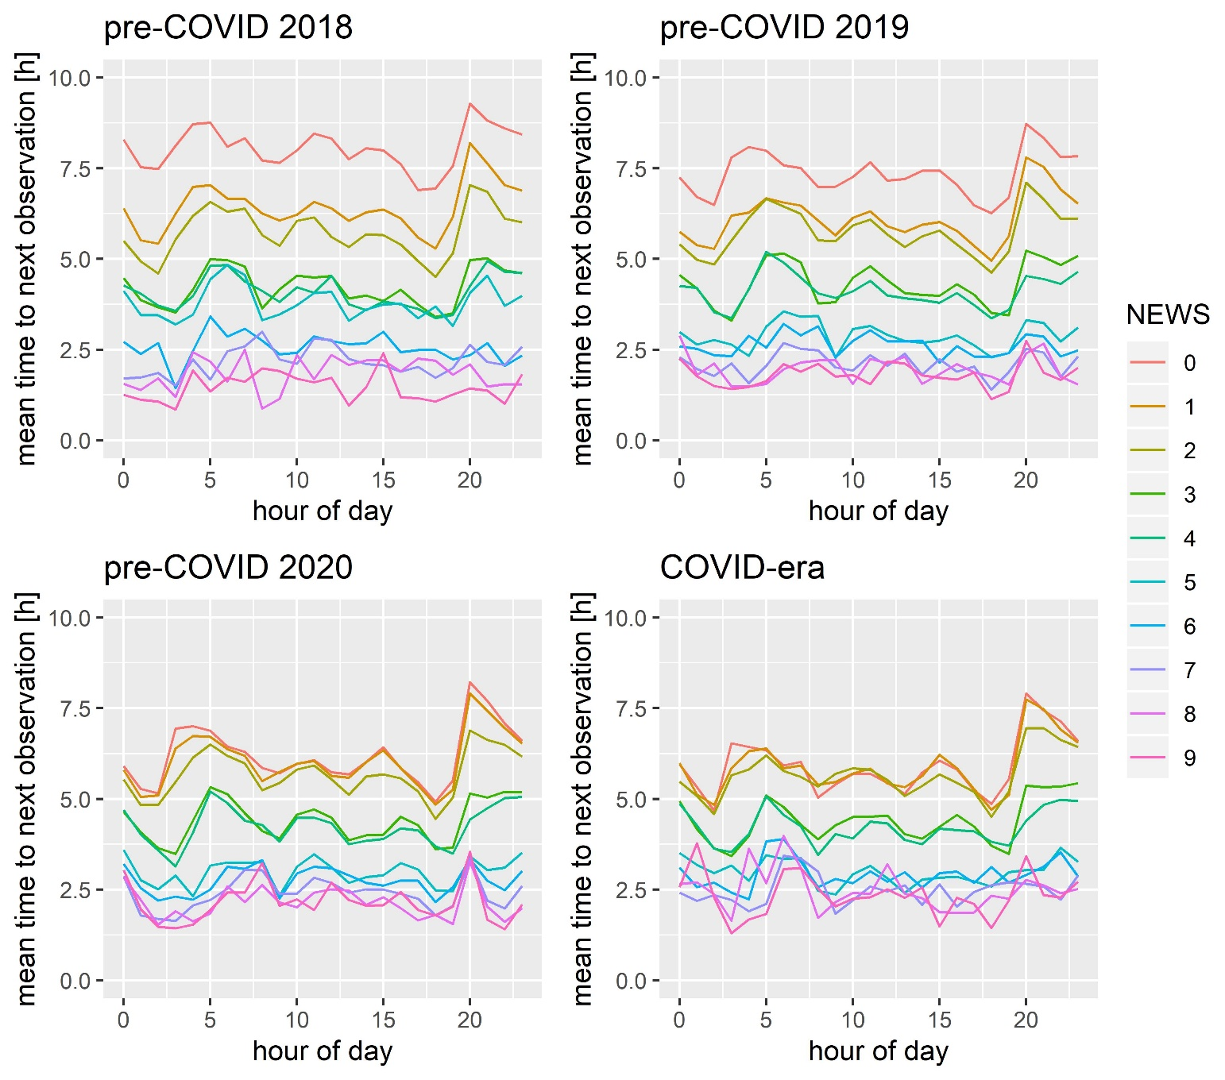
Observation patterns

Slide 16
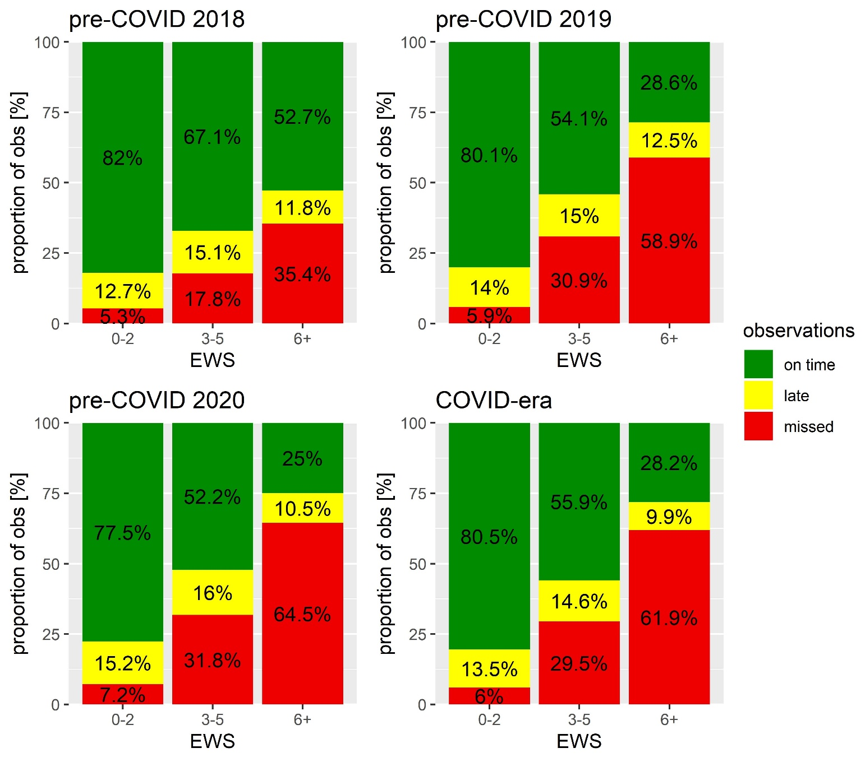
Compliance with protocol

Slide 17
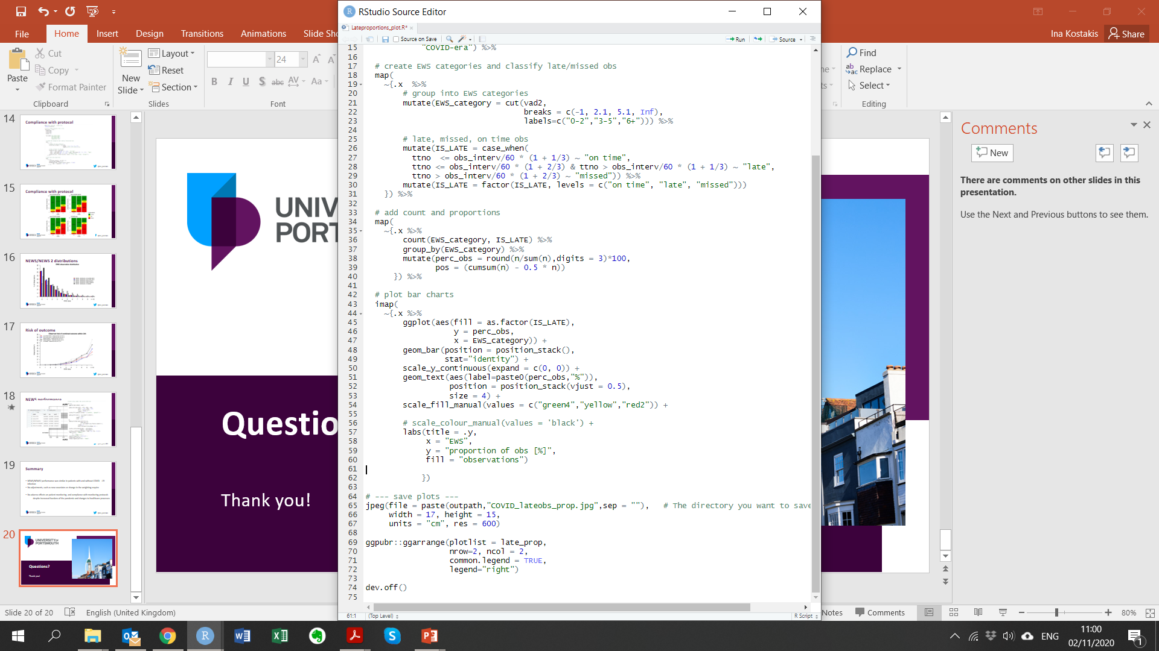
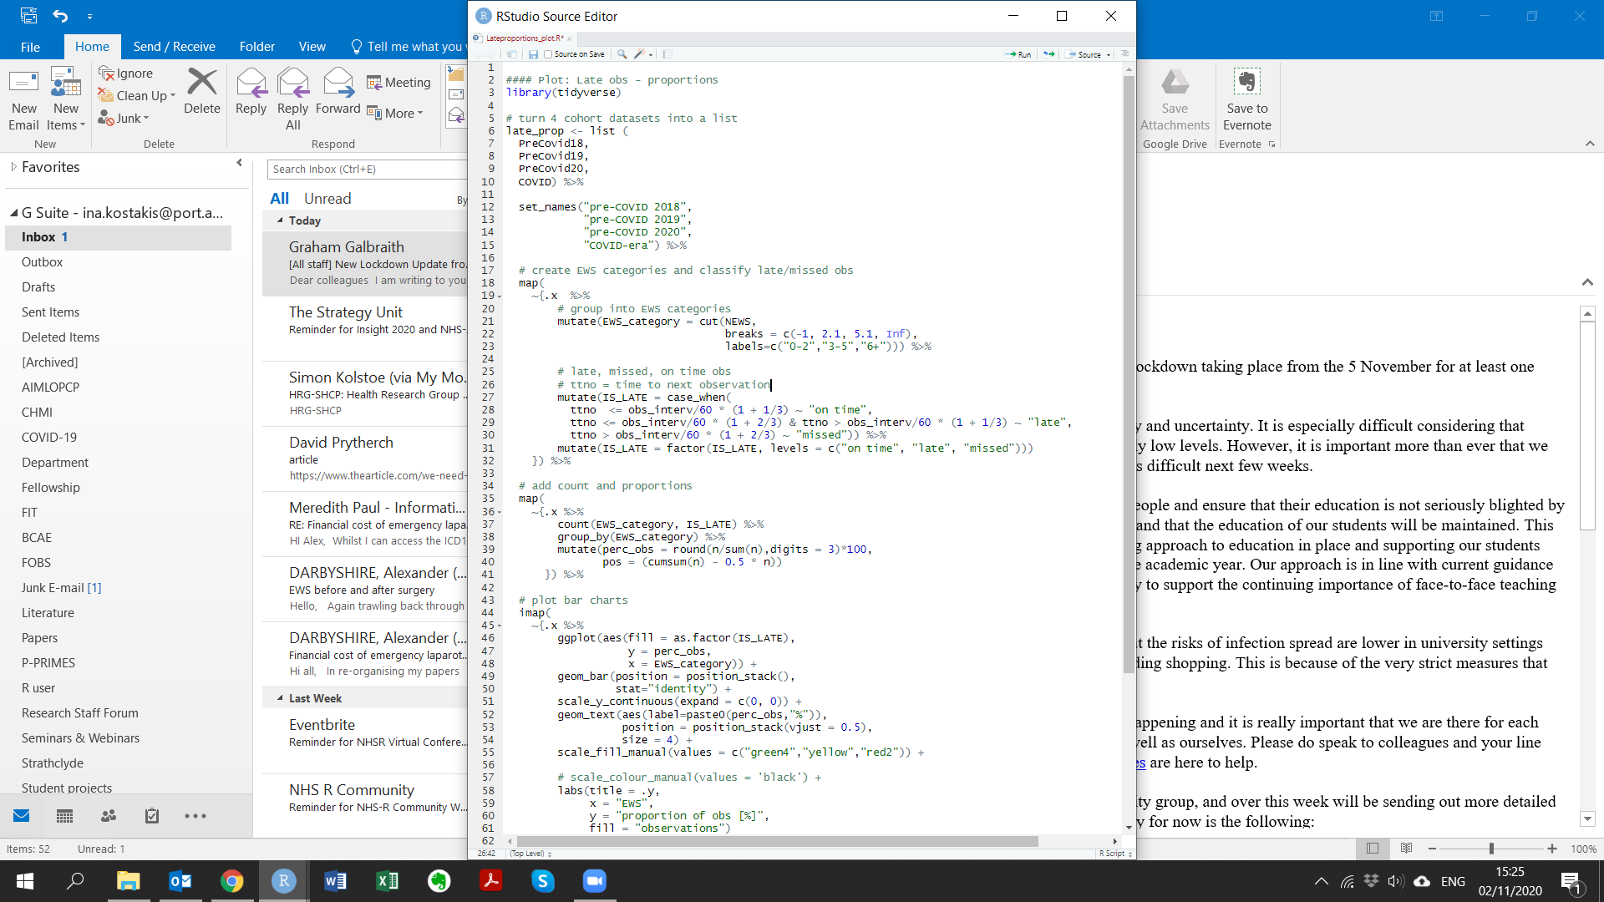
Compliance with protocol

Slide 18
Compliance with protocol

Slide 19
Summary
NEWS/NEWS2 performance was similar in patients with and without COVID-19 infection
No adjustments, such as new covariates or change in the weighting, required
No adverse effects on patient monitoring and compliance with monitoring protocols
despite increased burdens of the pandemic and changes to healthcare processes

Slide 20

Questions?
Thank you!

